Slide 1
Git Fundamentals
Dr. Prashant Aparajeya

Slide 2
Course Objectives
• Understand what version control is and why Git is used
• Learn the core Git commands and workflows
• Master branching, merging, and conflict resolution
• Work confidently with remote repositories and GitHub
• Develop effective collaboration strategies for team-based projects

Slide 3
Module 1: Introduction to Version Control with Git

Slide 4
Local Copy Methods
Before formal version control systems, developers often relied on simple local copy methods:
Manual backups: Copying files to separate folders with date stamps
Commenting out code: Preserving old versions within the same file
Zip archives: Compressing project folders at different stages
These methods, while simple, have significant drawbacks:
Limited history tracking
Difficulty in collaboration
Increased risk of data loss
Inefficient storage use

Slide 5
Formal Version Control Systems
Modern version control systems offer sophisticated features:
Comprehensive history: Detailed logs of all changes
Branching and merging: Support for parallel development
Collaboration tools: Mechanisms for multiple developers to work together
Backup and restore: Easy recovery of previous versions

Slide 6
Git: A Distributed Version Control System
Git is a distributed version control system created by Linus Torvalds in 2005. It has become the de facto standard for version control, with nearly 95% of developers reporting it as their primary system as of 2022.
Key features of Git include:
Distributed nature: Every developer has a full copy of the repository
Speed and efficiency: Designed for performance, even with large projects
Branching and merging: Powerful tools for non-linear development
Data integrity: Uses cryptographic hashing to ensure data consistency

Slide 7
Basic Git Terminology
To understand Git, it's crucial to familiarize yourself with these key terms:
Repository: A container for a project, including all files and their version history.
Commit: A snapshot of changes at a specific point in time. Each commit has a unique identifier and contains:
Changes made to files
Author and timestamp
Message describing the changes
Working Directory: The folder on your local machine where you're actively working on files.
Staging Area: An intermediate area where changes are prepared before committing. Also known as the "index," it allows you to selectively choose which changes to include in the next commit.
HEAD: A pointer that refers to the latest commit in the current branch. It represents your current working state and the base for new changes.

Slide 8
Git Workflow
The basic Git workflow involves three main states:
Modified: Changes have been made to files in the working directory but not yet staged or committed.
Staged: Modified files have been marked to be included in the next commit.
Committed: Changes have been safely stored in the local repository.
This workflow allows for a flexible and controlled approach to managing changes in your project.

Slide 9
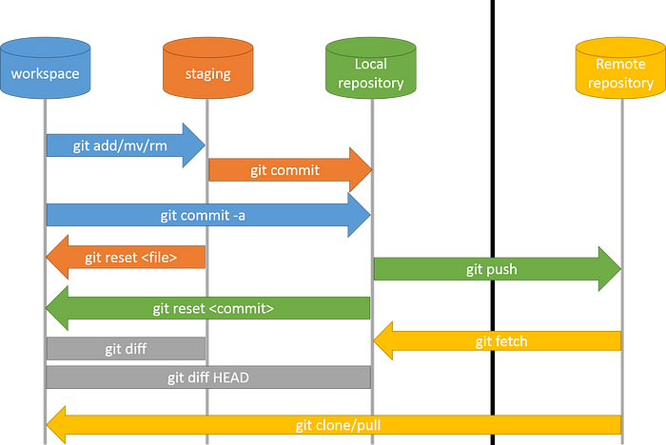
Git Workflow Diagram

Slide 10
Git Installation
How to install Git?
https://github.com/git-guides/install-git

Slide 11
Git Setup
Configure user name and email using:
$ git config --global user.name "Your Name"
$ git config --global user.email "you@example.com"

Slide 12
Git Setup
Creating a Repository:
– Open a terminal and create a new directory, then initialize Git:
$ mkdir <repo_name>
$ cd <repo_name>
$ git init

Slide 13
Git Setup
Basic Commands:
– Create a file (e.g., hello.txt), add text, and view status:
$ echo "Hello, Git!" > hello.txt
$ git status
– Stage the file and commit:
$ git add hello.txt
$ git commit -m "Initial commit: add hello.txt with greeting"
– Show commit history with:
$ git log --oneline --graph

Slide 14
Publishing Local Git Repo to Github
STEP 1: Create a New Repository on GitHub
Go to GitHub
Click on the "+" icon in the top-right corner and select New repository.
Give your repository a name (same name as you did on the local), set it to public or private, and DO NOT initialize it with a README (since you already have a local repo).
Click Create repository.
GitHub will provide you with a URL (something like https://github.com/your-username/repository-name.git). Keep this handy.

Slide 15
Publishing Local Git Repo to Github
STEP 2: Link Your Local Repository to GitHub
In your terminal or command prompt, navigate to your local project folder where Git is already initialized: $ cd /path/to/your/project
Now, add GitHub as the remote origin: $ git remote add origin https://github.com/your-username/repository-name.git
Check if the remote was added successfully: $ git remote -v

Slide 16
Publishing Local Git Repo to Github
STEP 2: Push Your Local Code to GitHub
Run the following commands:
$ git branch -M main # Ensure your branch is named 'main' (or 'master' if you're using an older setup)
$ git add . # Stage all files
$ git commit -m "Initial commit" # Commit the files
$ git push -u origin main # Push your code to GitHub
If prompted, enter your GitHub credentials or use a Personal Access Token (PAT) if GitHub has disabled password authentication.
Go back to your GitHub repository page and refresh it. Your code should now be there!
Set up SSH authentication to avoid entering credentials every time.

Slide 17
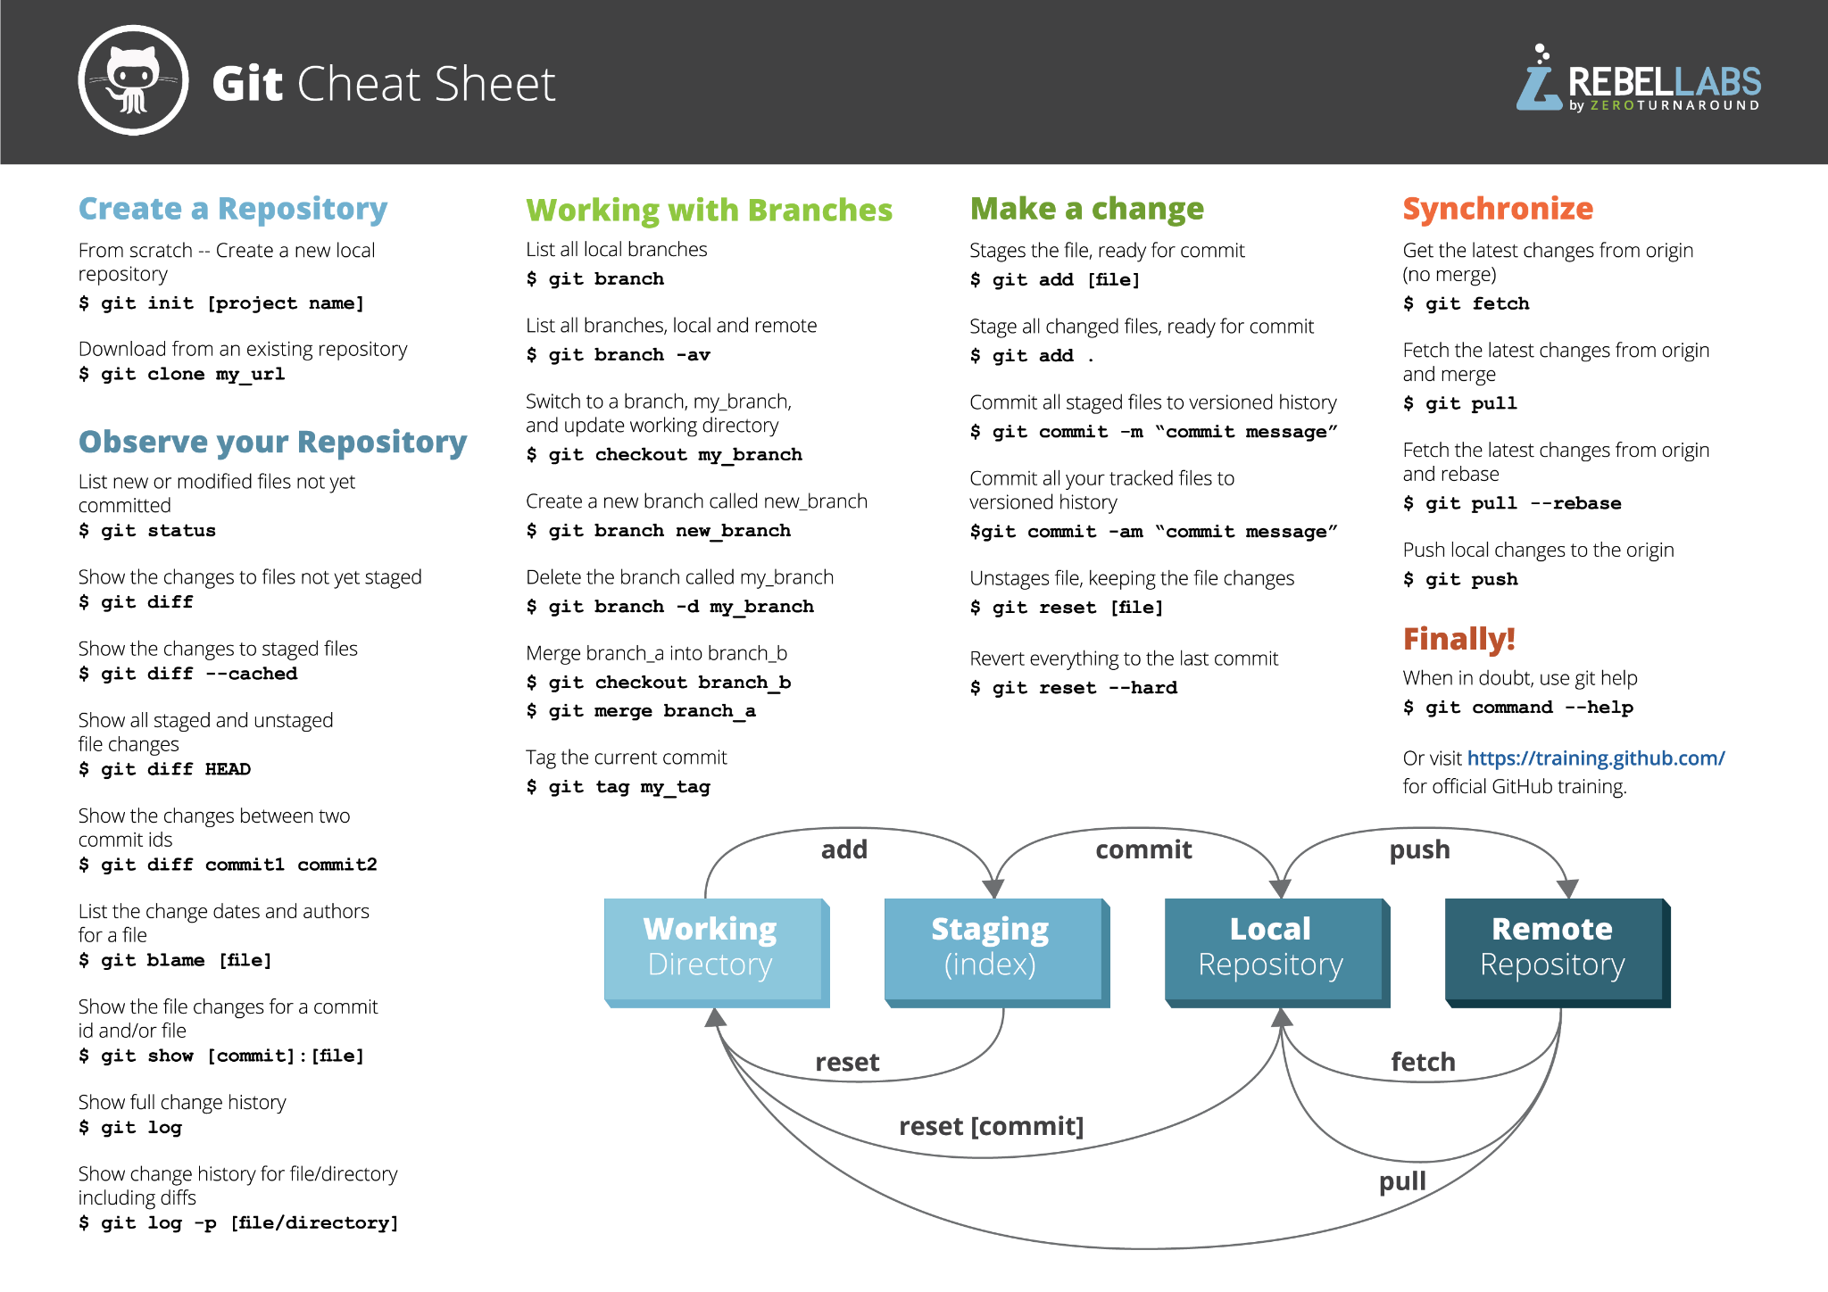

Slide 18
Module 2: Branching and Merging

Slide 19
What Are Branches in Git?
A branch in Git is a:
Lightweight, movable pointer to a commit.
It allows developers to create an isolated environment to work on:
features,
bug fixes, or
experiments
without affecting the main codebase.
Branches enable parallel development and provide a way to merge changes back into the main project when they are ready.
Default Branch: When a Git repository is initialized, the first branch created is the default branch. Historically, this branch was named master, but many platforms like GitHub and GitLab now use main as the default for inclusivity and standardization. The default branch typically represents the production-ready version of the codebase

Slide 20
Create a Branch Locally
You can create a branch using different methods:
Method 1: Using git branch & git checkout (Older Way)
$ git branch new-branch # Create a new branch
$ git checkout new-branch # Switch to the new branch
Method 2: Using git checkout -b (Shortcut)
$ git checkout -b new-branch
Method 3: Using git switch (Recommended for Newer Git Versions)
$ git switch -c new-branch
After creating the branch, verify it using:
$ git branch # This will list all branches, with the current one highlighted

Slide 21
Push the New Branch to GitHub
Once the branch is created, push it to GitHub:
$ git push -u origin new-branch
The -u flag sets this branch to track the remote branch, so future git push or git pull commands will work without specifying the branch name.
Alternative Ways to Push the New Branch
If you've already created and switched to the new branch, you can use:
$ git push --set-upstream origin new-branch
or simply:
$ git push origin new-branch
(but this won't set upstream tracking automatically)

Slide 22
Making Changes on a Branch
Modify a file (e.g., update hello.txt with new content) and commit.

Slide 23
Merging Branches
Merging branches in Git allows you to integrate changes from one branch into another.
There are several ways to merge branches, depending on the needs. Here are the most common methods:
Fast-Forward
Three-Way Merge
Squash Merge
Rebase Merge
Conflict Resolution

Slide 24
Fast-Forward
Use When: The target branch has no new commits since the branch was created.
Effect: Moves the target branch pointer to the new branch without creating a merge commit.
How to Use:
$ git checkout main # Switch to the main branch
$ git merge feature-branch # Merge the feature branch into main
or using switch:
$ git switch main
$ git merge feature-branch
No extra commit is created.

Slide 25
Three-Way Merge (Default)
Use When: Both branches have new commits.
Effect: Creates a new merge commit.
How to Use:
$ git checkout main # Switch to the main branch
$ git merge feature-branch # Merge the feature branch into main

Slide 26
Squash Merge
Use When: You want to combine multiple commits into a single commit before merging.
Effect: Keeps the history clean by squashing all changes into one commit.
How to Use:
$ git checkout main # Switch to the main branch
$ git merge --squash feature-branch # Merge the feature branch into main
$ git commit -m "Merged feature-branch with squashed commits"

Slide 27
Rebase Merge
Use When: You want a linear history without merge commits.
Effect: Moves the feature branch commits to the latest main branch, avoiding a merge commit.
How to Use:
$ git checkout feature-branch
$ git rebase main # Replays commits on top of main
$ git checkout main
$ git merge feature-branch # Fast-forward merge
Or
$ git rebase main feature-branch # Rebase without switching branches

Slide 28
Merge with Conflict Resolution
Use When: There are conflicting changes in the same file on both branches.
Effect: Git prompts you to manually resolve conflicts before merging.
How to Use:
$ git checkout main # Switch to the main branch
$ git merge feature-branch # Merge the feature branch into main
If conflicts occur:
$ git status # See conflicting files
$ nano filename # Edit and resolve conflicts manually
$ git add filename
$ git commit -m "Resolved merge conflict"

Slide 29
Which Merge Strategy Should You Use?
Merge Type | Best For
Fast-Forward | Small updates, keeping history simple
Three-Way Merge | When multiple branches have diverged
Squash Merge | Clean history for feature branches
Rebase Merge | Linear history, avoiding merge commits
Conflict Resolution | When there are conflicts

Slide 30
Visualising Branches
$ git log --graph --oneline --all

Slide 31
Module 3: Conflict Resolution

Slide 32
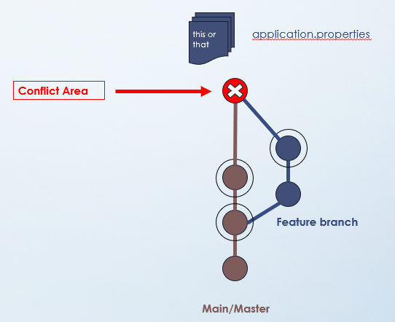
Objectives
Learn to identify and resolve conflicts manually.
Practice using merge tools and understanding Git’s conflict markers.
Develop best practices to minimize conflicts.

Slide 33
How Conflicts Occur in Git
Conflicts in Git occur when two branches modify the same lines in a file or when one branch modifies a file that another branch deletes. These situations arise during a merge or rebase operation, as Git cannot automatically determine which changes to keep.
Example of Conflict Scenario:
Branch A (Current Branch) modifies line 10 of file.txt
Branch B (Incoming Branch) also modifies line 10 of file.txt differently.
When merging Branch B into Branch A, Git detects the conflicting changes and pauses the merge process, requiring manual intervention.

Slide 34
Conflict Markers in Git
When a conflict occurs, Git marks the conflicting sections in the file with conflict markers. These markers highlight the differences between the current branch (HEAD) and the incoming branch.
Example of Conflict Markers
<<<<<<< HEAD
Current branch changes
=======
Incoming branch changes
>>>>>>> feature-update
<<<<<<< HEAD : Marks the start of the changes from your current branch.
======= : Separates the changes from your current branch and the incoming branch.
>>>>>>> [branch-name] : Marks the end of the incoming branch's changes.

Slide 35
Resolving Conflicts
To resolve conflicts, you must manually edit the file to decide which changes to keep. You can:
Keep one version (either HEAD or incoming branch).
Combine both changes into a new version.
Remove unnecessary lines.

Slide 36
Tools to Help Resolve Conflicts
Command Line: Use
$ git status
to identify conflicted files and manually edit them.
Conflict Editors: Many IDEs (e.g., VSCode, IntelliJ) provide visual tools for resolving conflicts.
Git Platforms: Platforms like GitHub or GitLab offer inline editors for resolving simple conflicts directly on their interfaces

Slide 37
Module 4: Using Remote Repositories

Slide 38
Objectives
Cloning
Synchronizing
Configuring Remote Tracking Branches in Git

Slide 39
How to Clone a Repository from a Remote Server
Cloning a repository creates a local copy of a remote repository, allowing you to work on the project locally.
Basic Command:
$ git clone <repository-url> # Replace <repository-url> with the HTTPS or SSH URL of the repository (e.g., from GitHub, GitLab, etc.).
Cloning into a Specific Directory:
$ git clone <repository-url> <directory-name> # This clones the repository into the specified directory.
Cloning a Specific Branch:
$ git clone -b <branch-name> <repository-url> # Use this to clone only the branch you need.
Cloning with SSH (requires SSH key setup):
$ git clone git@github.com:user/repository.git # This method is secure and avoids repeated password prompts.

Slide 40
Understand How to Synchronize Local and Remote Changes
To ensure your local repository is up-to-date with the remote repository, you need to synchronize changes.
Fetch Changes: $ git fetch # This downloads changes from the remote repository but does not merge them into your local branch.
Pull Changes: $ git pull # This fetches changes and merges them into your current branch. If there are conflicts, Git will pause for manual resolution.
Push Local Changes to Remote: $ git push # This uploads your committed changes from the local branch to the corresponding remote branch.

Slide 41
Set Up and Configure Remote Tracking Branches
Remote tracking branches link your local branches to their remote counterparts, enabling seamless synchronization.
Fetch All Remote Branches: $ git fetch --all # Retrieves metadata for all remote branches without checking them out locally.
Create a Local Branch Tracking a Remote Branch: $ git checkout -b <local-branch-name> origin/<remote-branch-name> # This creates a new local branch and sets it to track the specified remote branch automatically.
Set an Existing Local Branch to Track a Remote Branch: $ git branch --set-upstream-to=origin/<remote-branch-name> <local-branch-name> # This links an already existing local branch to a remote branch for tracking purposes.
Change Tracking for an Existing Branch: $ git branch -u origin/<new-remote-branch> <local-branch-name> # Updates the tracking configuration if you need to point your local branch to a different remote branch.

Slide 42
Module 5: Strategies for Team Collaboration Using Git

Slide 43
Objectives
Understand different collaborative workflows and select one that fits your team’s needs.
Set up a team workflow using branches, pull requests, and CI.
Learn techniques for handling complex merge scenarios and large-team challenges.

Slide 44
Popular Git Workflows for Collaboration
Git workflows define how teams collaborate on repositories, manage branches, and integrate changes. Below are three widely-used Git workflows:
Feature Branch Workflow
Git Flow Workflow
Forking Workflow

Slide 45
Feature Branch Workflow
Overview: Each new feature or bug fix is developed in its own branch, separate from the main branch.
Advantages:
Isolates development work, ensuring the main branch remains stable.
Simplifies code reviews and testing before merging.
Steps:
Create a new branch for the feature: $ git checkout -b feature/feature-name main
Work on the feature and commit changes.
Push the branch to the remote repository: $ git push -u origin feature/feature-name
Open a pull request (PR) for review and merge into main when approved.

Slide 46
Git Flow Workflow
Overview: A more structured approach with multiple branches:
develop,
release,
Hotfix
to manage different stages of development.
Branch Types:
main : Production-ready code.
develop : Integration branch for features.
feature/* : Individual features branched off develop.
release/* : Prepares code for release.
hotfix/* : Urgent fixes branched off main.
Advantages:
Clear separation of stable and experimental code.
Ideal for projects with scheduled releases.
Commands:
$ git checkout -b develop main
$ git checkout -b feature/feature-name develop

Slide 47
Forking Workflow
Overview: Each developer forks the central repository into their own remote repository. Changes are made in the fork and submitted as pull requests to the main repository.
Advantages:
Useful for open-source projects with external contributors.
Maintains control over the central repository.
Steps:
Fork the repository on GitHub/GitLab.
Clone your fork locally: $ git clone <forked-repo-url>
Make changes in a new branch, push to your fork, and open a PR.

Slide 48
Integrating Code Reviews, Continuous Integration (CI), and Automated Testing
Collaboration is enhanced by integrating tools that ensure code quality and streamline development processes.
b) Continuous Integration (CI)
CI automates testing whenever changes are pushed to a repository or merged into key branches like develop or main.
Tools like GitHub Actions, Jenkins, or Travis CI clone the repository, build the project, and run tests automatically.
Example CI Workflow with GitHub Actions:
name: CI Pipeline
on: [push, pull_request]
jobs:
build-and-test:
runs-on: ubuntu-latest
steps:
- uses: actions/checkout@v2
- name: Run Tests
run: npm test
Benefits:
Detects issues early in development.
Ensures merged code is functional and stable.
a) Code Reviews
Conducted via pull requests (PRs).
Developers propose changes, and team members review them for quality, consistency, and functionality before merging into main.
Use comments and suggestions to improve collaboration.
c) Automated Testing
Write unit tests to cover critical parts of your codebase.
Configure CI tools to run these tests automatically on every commit or PR.
Example Tools: Jest (JavaScript), PyTest (Python), JUnit (Java).
Use a build matrix to test across multiple environments (e.g., OS or language versions).

Slide 49
References:
GIT-SCM.COM – Git SCM Book – Getting Started
FREECODECAMP.ORG – freeCodeCamp “What is Git? A Beginner’s Guide”
EDUCATION.MOLSSI.ORG – MolSSI Education: Introduction to Version Control using Git

Slide 50

Practice Coding – A LOT

Slide 51


